Slide 1
MATHEMATICAL MODEL P3

Slide 2
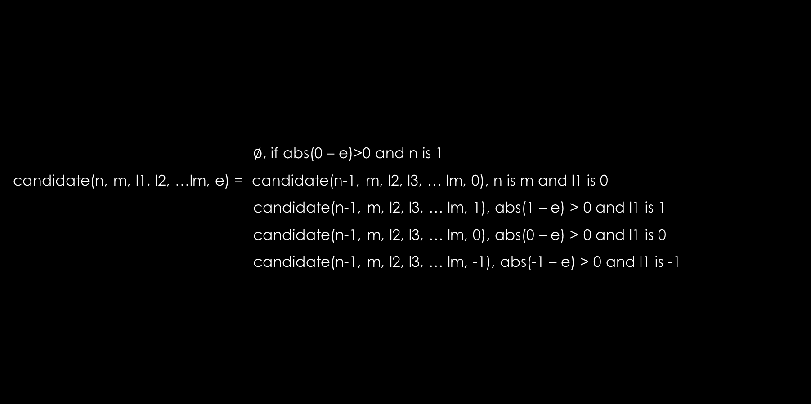
$∅$, if abs(0 – e)>0 and n is 1
candidate(n, m, l1, l2, …lm, e) = candidate(n-1, m, l2, l3, … lm, 0), n is m and l1 is 0
candidate(n-1, m, l2, l3, … lm, 1), abs(1 – e) > 0 and l1 is 1
candidate(n-1, m, l2, l3, … lm, 0), abs(0 – e) > 0 and l1 is 0
candidate(n-1, m, l2, l3, … lm, -1), abs(-1 – e) > 0 and l1 is -1

